Slide 1

Basic Details of the Team and Problem Statement
Ministry/Organization Name/Student Innovation:
Ministry of AYUSH
PS Code: SIH1345
Problem Statement Title: Startup-AYUSH Portal
Team Name: Incredibles
Team Leader Name: Shashank M
Institute Code (AISHE): U-0725
Institute Name: Reva University
Theme Name: MedTech / BioTech / HealthTech

Slide 2
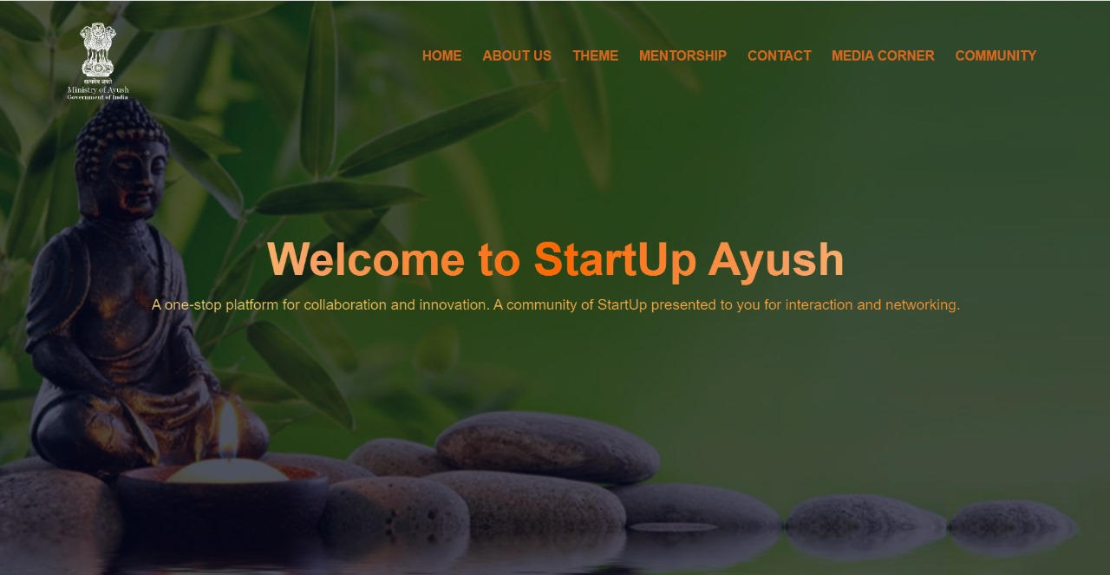
Idea/Approach Details
Idea/Solution/Prototype here:
Building a collaborative platform and a dynamic environment for all the Stakeholders which includes startups, Investors, Government Agencies, Public users, Incubators and Accelerators.
The AYUSH Startup community will be united through virtual connections, mentorship, and opportunities for showcasing.
Abundant resources and informative guides will be available to support everyone on their entrepreneurial path within the AYUSH domain.
Technology stack here:
We create a personalized experience through our website for the stakeholders which is a never before technology by Ministry of AYUSH.
We will establish a Community Forum that fosters a sense of camaraderie, mutual assistance, and knowledge sharing among its members.
A user-friendly AI chatbot designed to simplify tasks for users.

Slide 3
Idea/Approach Details
Describe your Use Cases here
Describe your Dependencies / Showstopper here
Knowledge repository
Social collaboration
Personalized records
User friendly AI chatbot
Funding and investment opportunities
Mentorship and advisory services
Pitch Competitions
Success stories and case studies
Possibilities for Advancing Traditional Medical Practices
Education and awareness about Ayurveda
Authentication and authorization: Users can’t access variety of features until they create an account in the portal.
Ayurvedic Content: The chatbot responds to user’s query based on the ayurvedic dataset .
User Forums: The community must include stakeholders with varying background and expertise.

Slide 4
Team Member Details
Team Leader Name: Shashank M
Branch: B.Tech Stream CSE Year III
Team Member 1 Name: Yashas Kishore
Branch: B.Tech Stream CSE : Year III
Team Member 2 Name: Shreyas
Branch: B.Tech Stream CSE : Year III
Team Member 3 Name: Khushi Prabhu
Branch: B.Tech Stream CSE Year III
Team Member 4 Name: Srinidhi R Bharadwaj
Branch: B.Tech Stream CSE Year III
Team Member 5 Name: Dhaarini K N Hathwar
Branch: B.Tech Stream CSE Year III
Team Mentor Name: Prof. Bindushree D C
Category (Academic/Industry): Academic, Assistant Professor
Expertise: Data Mining, Machine Learning, Healthcare Analytics, Data Science
Domain Experience (in years): 10 years

